Slide 1
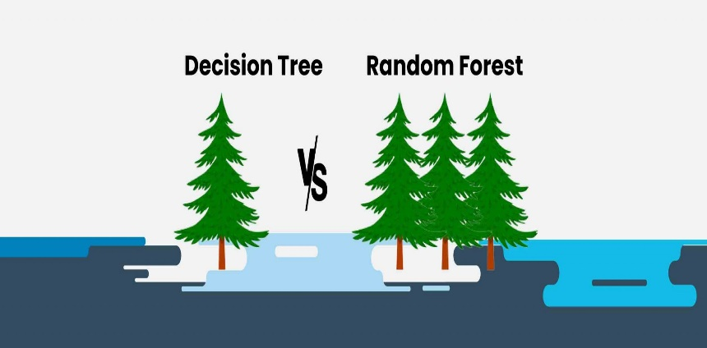
Ensemble Learning
11
- Dr. Sifat Momen (SfM1)

Slide 2
Learning goals
After this presentation, you should be able to
Appreciate the use of ensemble techniques
Understand the general idea of Ensemble Approach
Understand the idea of Bagging and Pasting
Understand OOB evaluation
Understand and Apply Random Forest Algorithm

Slide 3
Jupyter Notebook
Please note that there is an associated Jupyter notebook with this presentation
Please use both in parallel for optimal understanding

Slide 4
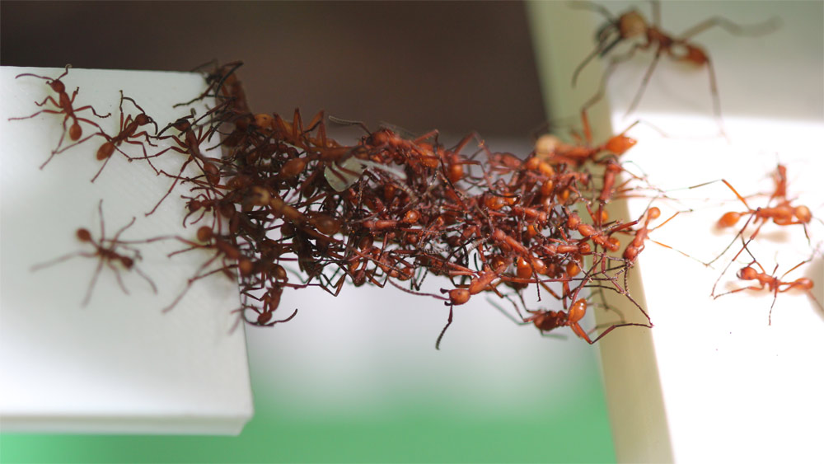
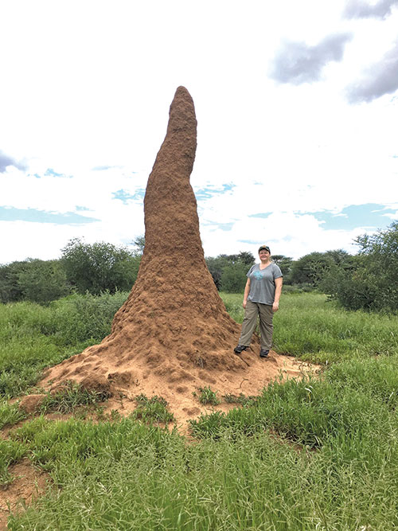

Wisdom of the crowd

Slide 5
Ensemble Methods
Construct a set of base classifiers learned from the training data
Predict class label of test records by combining the predictions made by multiple classifiers (e.g., by taking majority vote)

Slide 6
Necessary Conditions for Ensemble Methods
Ensemble Methods work better than a single base classifier if:
All base classifiers are independent of each other
All base classifiers perform better than random guessing (error rate < 0.5 for binary classification)

Slide 7
General Approach of Ensemble Learning
Using majority vote or weighted majority vote
(weighted according to their accuracy or relevance)

Slide 8
Constructing Ensemble Classifiers
By manipulating training set
Example: bagging, boosting, random forests
By manipulating input features
Example: random forests
By manipulating class labels
Example: error-correcting output coding
By manipulating learning algorithm
Example: injecting randomness in the initial weights of ANN

Slide 9
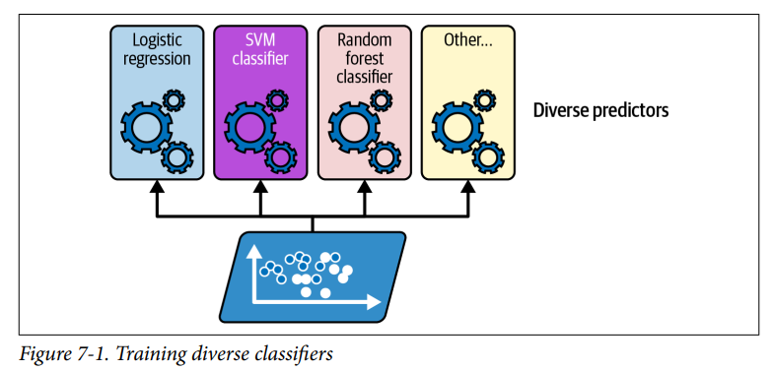
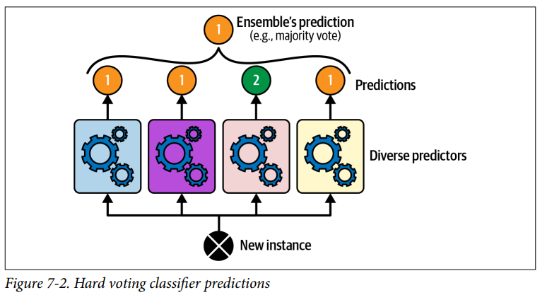
Voting Classifiers – Training Diverse Classifiers
Somewhat surprisingly, this voting classifier often achieves a higher accuracy than the best classifier in the ensemble.
In fact, even if each classifier is a weak learner (meaning it does only slightly better than random guessing), the ensemble can still be a strong learner (achieving high accuracy), provided there are a sufficient number of weak learners in the ensemble and they are sufficiently diverse.
If all classifiers are able to estimate class probabilities (i.e., if they all have a predict_proba() method), then you can tell Scikit-Learn to predict the class with the highest class probability, averaged over all the individual classifiers. This is called soft voting.

Slide 10
Voting Classifiers – Bagging and Pasting
One way to get a diverse set of classifiers is to use very different training algorithms, as just discussed.
Another approach is to use the same training algorithm for every predictor but train them on different random subsets of the training set.
When sampling is performed with replacement, this method is called bagging (short for bootstrap aggregating ).
When sampling is performed without replacement, it is called pasting

Slide 11
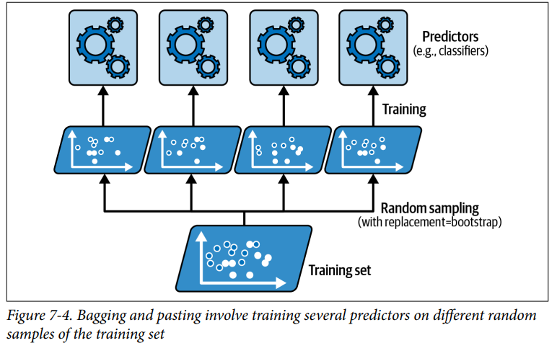
Voting Classifiers – Bagging and Pasting

Slide 12
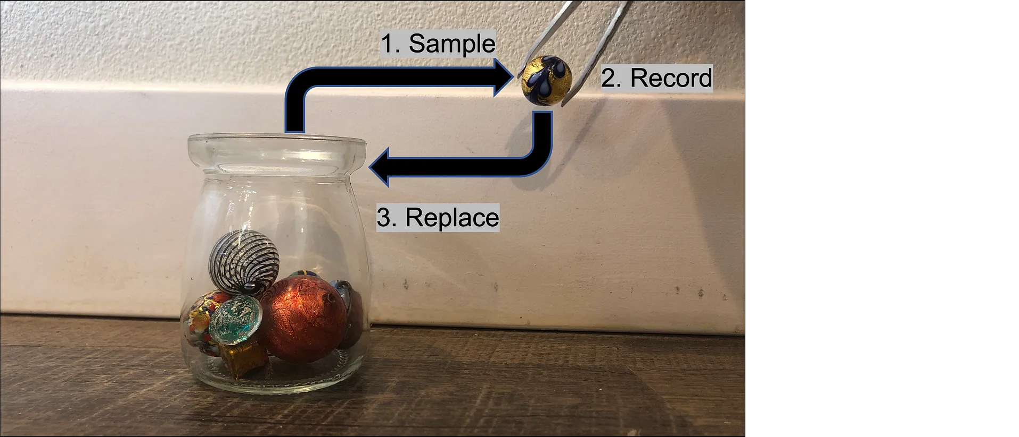
Sampling with replacement

Slide 13
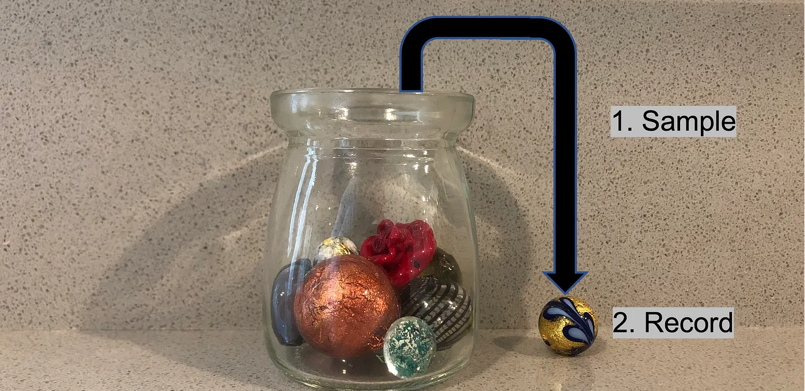
Sampling without replacement

Slide 14
Out of Bag Evaluation
With bagging, some training instances may be sampled several times for any given predictor, while others may not be sampled at all.
it can be shown mathematically that only about 63% of the training instances are sampled on average for each predictor.
Probability of a training instance being selected in a bootstrap sample is:
1 – (1 - 1/n)^{n} (n: number of training instances)
~0.632 when n is large

Slide 15
Out of Bag Evaluation
The remaining 37% of the training instances that are not sampled are called out-of-bag (OOB) instances. Note that they are not the same 37% for all predictors.

Slide 16
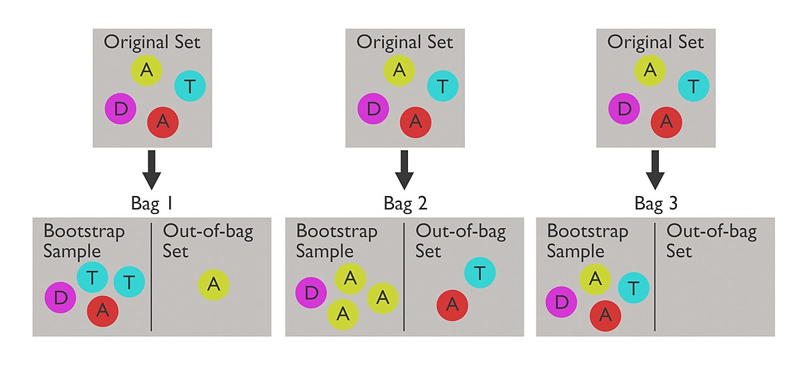
Out of Bag Evaluation

Slide 17
Out of Bag Evaluation
A bagging ensemble can be evaluated using OOB instances, without the need for a separate validation set: indeed, if there are enough estimators, then each instance in the training set will likely be an OOB instance of several estimators, so these estimators can be used to make a fair ensemble prediction for that instance.
Once you have a prediction for each instance, you can compute the ensemble’s prediction accuracy (or any other metric).
In Scikit-Learn, you can set oob_score=True when creating a BaggingClassifier to request an automatic OOB evaluation after training.

Slide 18
Bagging Example
Consider 1-dimensional data set:
Classifier is a decision stump (decision tree of size 1)
Decision rule: x ≤ k versus x > k
Split point k is chosen based on entropy
x ≤ k
True
False
y_{left}
y_{right}

Slide 19
Bagging Example

Slide 20
Bagging Example

Slide 21
Bagging Example

Slide 22
Bagging Example
Summary of Trained Decision Stumps:

Slide 23
Bagging Example
Use majority vote (sign of sum of predictions) to determine class of ensemble classifier
Bagging can also increase the complexity (representation capacity) of simple classifiers such as decision stumps
Predicted Class

Slide 24
Random Forest Algorithm
Construct an ensemble of decision trees by manipulating training set as well as features
Use bootstrap sample to train every decision tree (similar to Bagging)
Use the following tree induction algorithm:
At every internal node of decision tree, randomly sample p attributes for selecting split criterion
Repeat this procedure until all leaves are pure (unpruned tree)

Slide 25
